Slide 1
GREEN UNIVERSITY OF BANGLADESH DEPARTMENT OF COMPUTER SCIENCE AND ENGINEERING
Presentation Topic:- Indexing and Hashing
Name: Md. Nur A Neouse
Id:-193002093
Section:-193(DB)
Name: Md. Jakirul Islam
Id:-193002101
Section:-193(DB)
This Photo by Unknown author is licensed under CC BY-SA.

Slide 2
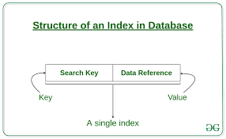




INDEXING IN DBMS
Indexing is used to optimize the performance of a database by minimizing the number of disk accesses required when a query is processed.
The index is a type of data structure. It is used to locate and access the data in a database table quickly.
It is defined based on the indexing attribute.
Ordered indices:- The indices are usually sorted to make searching faster. The indices which are sorted are known as ordered indices.

Slide 3
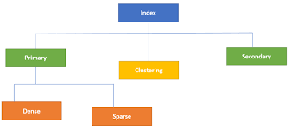

Slide 4
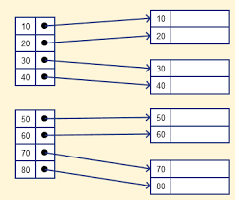
Sparse index
1. In the data file, index record appears only for a few items. Each item points to a block.
2. In this, instead of pointing to each record in the main table, the index points to the records in the main table in a gap

Slide 5
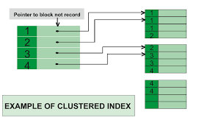
Clustering Index
A clustered index can be defined as an ordered data file. Sometimes the index is created on non-primary key columns which may not be unique for each record.
In this case, to identify the record faster, we will group two or more columns to get the unique value and create index out of them. This method is called a clustering index.
3. The records which have similar characteristics are grouped, and indexes are created for these group.

Slide 6
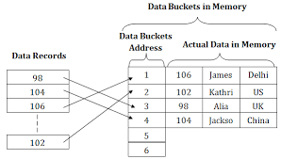
HASHING
In a huge database structure, it is very inefficient to search all the index values and reach the desired data. Hashing technique is used to calculate the direct location of a data record on the disk without using index structure.

Slide 7
THANK YOU

